Slide 1
Reading – The Master Skill
Supporting your child with their reading at home
Reception and Year 1

Slide 2


Tip 1
We as adults must try to demonstrate:
a love of reading
the purpose for reading
excitement and enthusiasm for reading

Slide 3

Tip 2
Read to your child.
Read to your child at every opportunity
Children who are read to at least three times a week by a family member are almost twice as likely to score in the top 25% in reading compared to children who are read to less than 3 times
a week (The Literacy Project, 2017)
Share stories, non-fiction books, poems, rhymes, newspapers, comic books, recipes, instruction manuals
Discuss words meanings and understanding of what you read to them

Slide 4
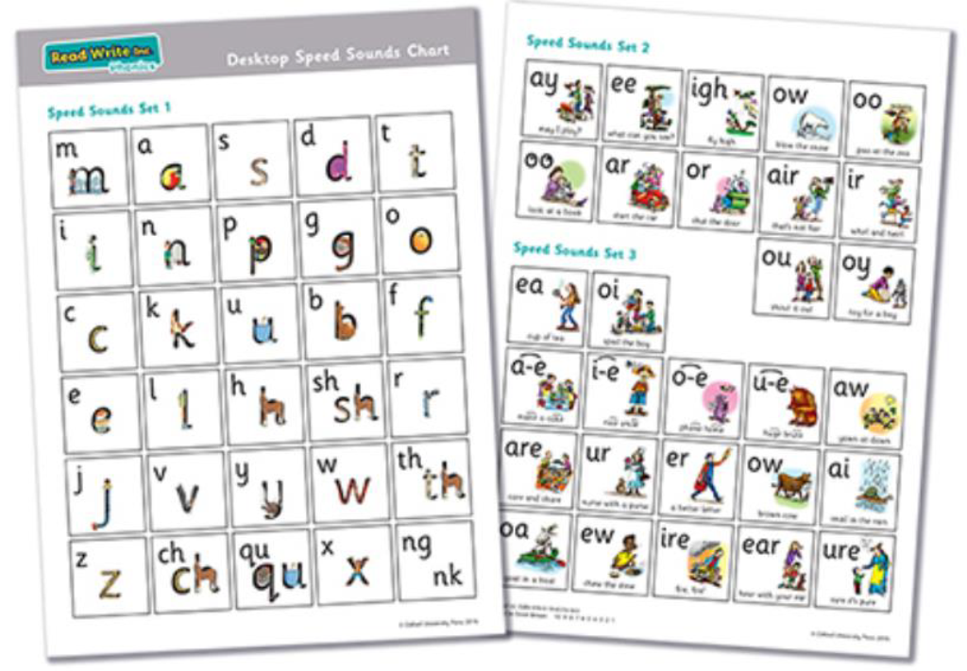
Tip 3
Practise sound cards
Little and often
Phoneme (sound), grapheme (how it is written), rhyme and action.
Trace them with a ‘Magic Finger’
Write them on card or paper
Make words with them
Pure sounds: https://www.youtube.com/watch?v=UCI2mu7URBc

Slide 5
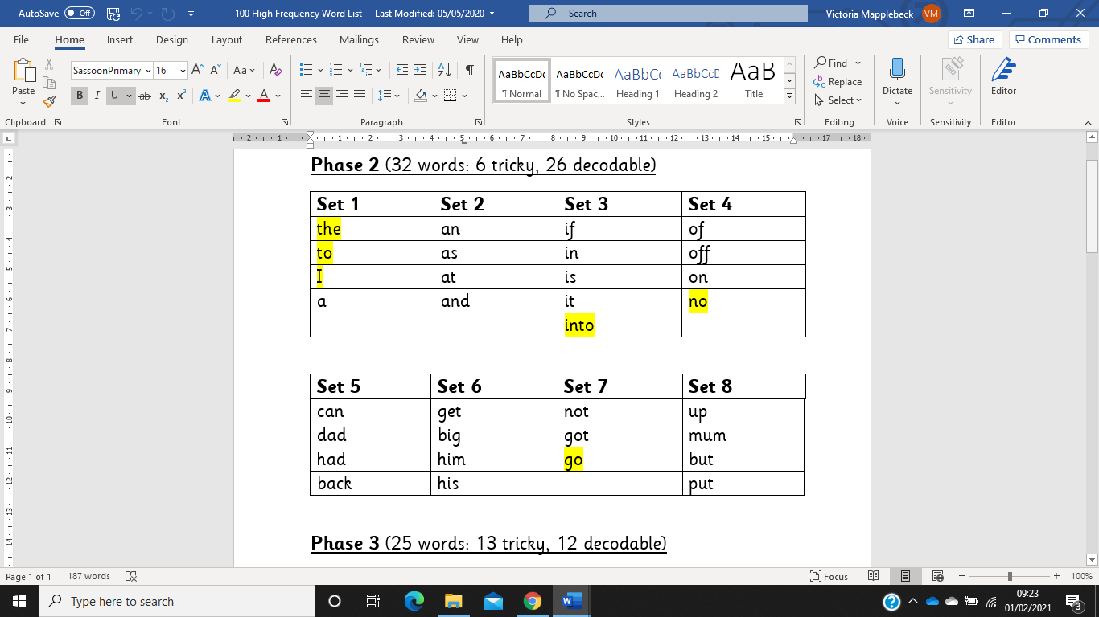
Tip 4
Practise high frequency words
Little and often
Write them on card or paper
Play games with them e.g. snap, pairs
Aim is for sight reading
Need to apply this learning when reading books on Active Learn

Slide 6

Tip 5
Where and When
Quiet environment
Minimal distractions
Time of day can make a big difference

Slide 7
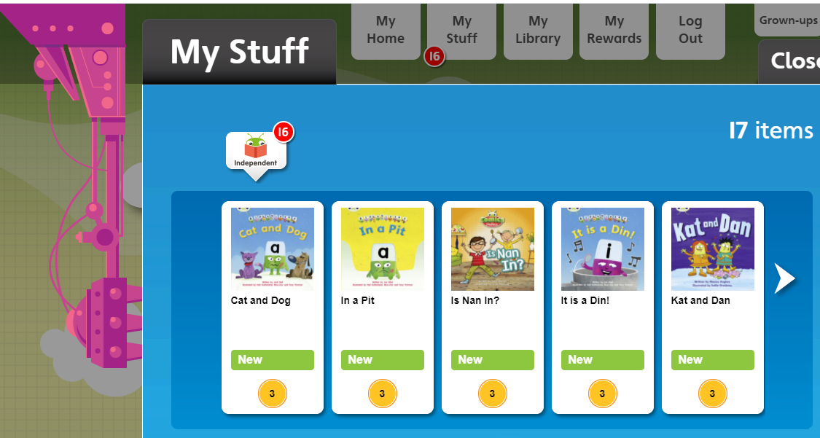
Tip 6
Use Active Learn
Little and often
Do not need to read full books
3 times per week – minimum
Would be reading daily in school
Books match those in school
Set by teachers for your child’s level

Slide 8
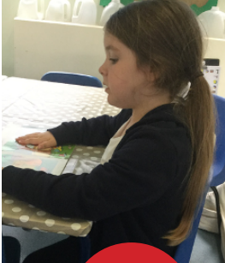
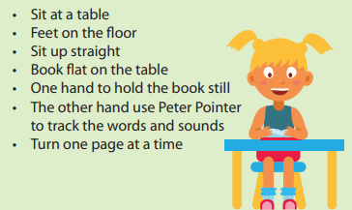
Tip 7
Reading Position

Slide 9

Tip 8
Ask Questions

Slide 10



Tip 9
Utilise Online Resources
Phonics Play
Education City
Espresso
Good for getting the children’s attention and encouraging engagement

Slide 11
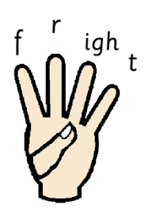
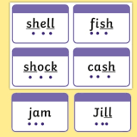
Tip 10
Reinforce terminology
Pure sounds – correct pronunciation]
Phoneme – sound
Grapheme – how sounds are written e.g. /ee/, /s/, /igh/
Digraph – two letters making one sound e.g. /ai/ in snail
Split digraph – two letters making one sound but split by another letter e.g. /a-e/ in cake
Trigraph – three letters making one sound e.g. /igh/ in high
Sounding out – reading a word by identifying the sounds e.g. f-ee-t
Blend – pushing the sounds back together after sounding out to make a word
Segment – break a word into the sounds to help us spell it e.g. cat, c-a-t
Fred Fingers – how we support sounding out, blending and segmenting
Sound buttons and lines – buttons = single letter sound, lines = digraphs, trigraphs

Slide 12

Thank you for joining us!
Please direct any questions to your child’s class teacher and they will be happy to help.
Keep going, you are doing an amazing job!

