Slide 1
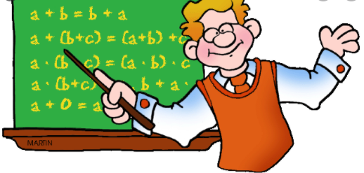
Maths Week
Inspiring Mathematicians!

Slide 2
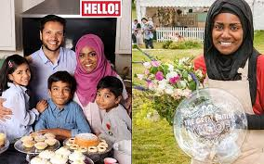
Monday
Nadiya Hassain
You may recognise her from The Great British Bake Off. She was the winner of the 6th Series in 2015. Since winning the show, she has become a TV presenter, columnist, author and has become an influential woman in many different ways.
How does she use maths?
Nadiya uses maths everyday when baking. To become a high class baker, you must be very precise with your ingredients. Nadiya has to weigh out every ingredient and check her recipes carefully. She also has to be very precise with her timings and know how long she needs to bake something for. Nadiya has become very successful, so she also needs maths to count all of her money!
https://www.nadiyahussain.com/
Here is a link to her website to search up some of her famous recipes.

Slide 3
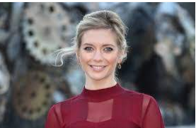
Tuesday
Rachel Riley
Rachel Riley is a mathematician and TV presenter. She has worked on Countdown since 2009 when she was just 22! Rachel had no experience of presenting before Countdown and got the role due to her maths skills!
How does she use maths?
On her show Countdown, Rachel is in charge of the number board! She presents contestants with a set of numbers and a total that they need to get to with those numbers. After the contestants have explained their workings out, Rachel has to very quickly check their answers and also come up with her own way of getting to the answer. Watch Rachel in action here (watch from 4.00 – 5.34): https://www.youtube.com/watch?v=9eMs_o08Gm4&safe=true

Slide 4
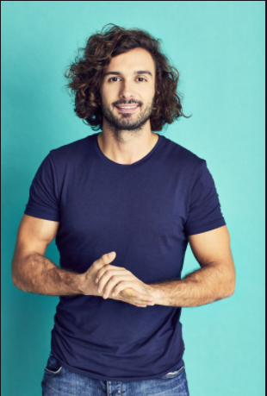
Wednesday
Joe Wicks
Joe Wicks is a fitness coach. He began his fitness career making small 15 second recipe videos online. His career grew, leading him to being one of the most followed fitness accounts on Instagram and YouTube.
How does he use maths?
Joe’s degree at university was Sports Science which involved lots of maths. In his job today Joe uses maths to design his high intensity workouts so they have maximum impact eg. 10 burpees and then 20 sit ups! Joe also uses maths to calculate resting and active heart rates of those he is training and when working out the calories in the foods he makes to keep himself and others fit and healthy.

Slide 5
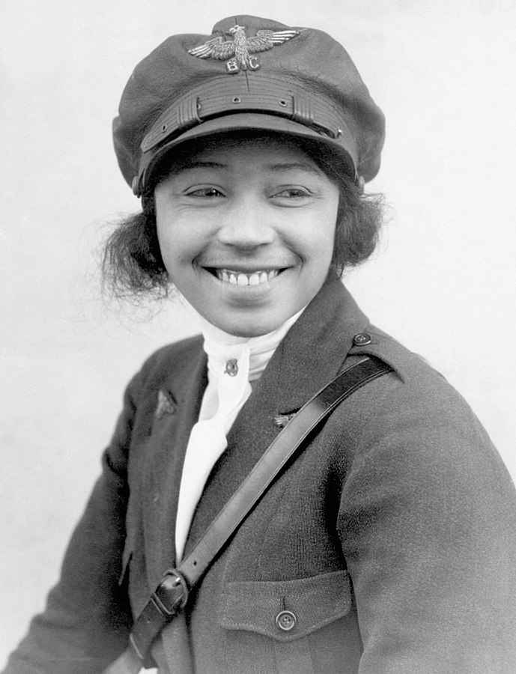
Thursday
Bessie Coleman
Bessie Coleman was an early American civil aviator. She was the first African-American woman, and also the first Native-American, to hold a pilot license. She earned her pilot license from the Fédération Aéronautique Internationale on June 15, 1921, and was the first black person to earn an international pilot's license.
How did she use maths?
Bessie had to use her maths and problem solving skills to learn how to use the controls and instruments. Bessie also had to be able to read maps to know where her plane was flying from and to and what the quickest and safest route would be. When flying, Bessie had to keep a flight log of her altitudes and distance to her destination.

Slide 6
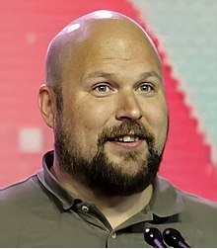
Friday
Markus Persson
Markus Persson is a swedish video game programmer and designer. He is most well known for creating Minecraft in 2011 which has now become the best selling game of all time.
How does he use maths?
Video games use algorithms to work. These are a bit like sums that make the game and characters look and do certain things. When designing the game, Markus would have had to create lots of different algorithms, using lots of numbers and equations! Minecraft also uses shapes and blocks. When designing the game, Markus would have had to know his shapes and how they look and fit together.

