Slide 1
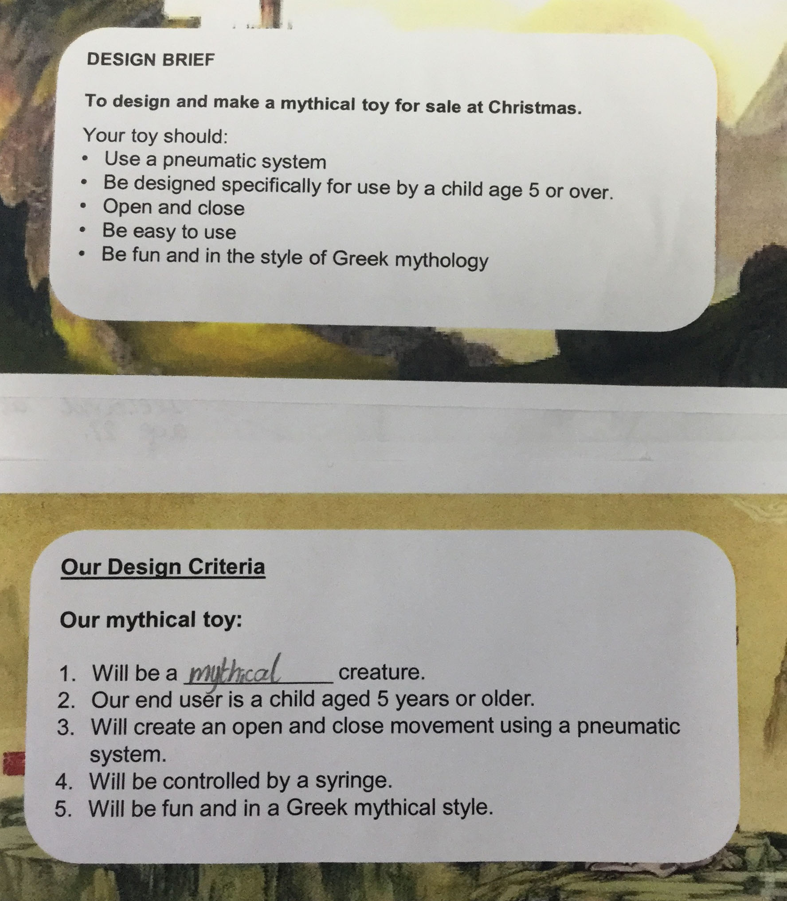
Design Brief
Criteria

Slide 2
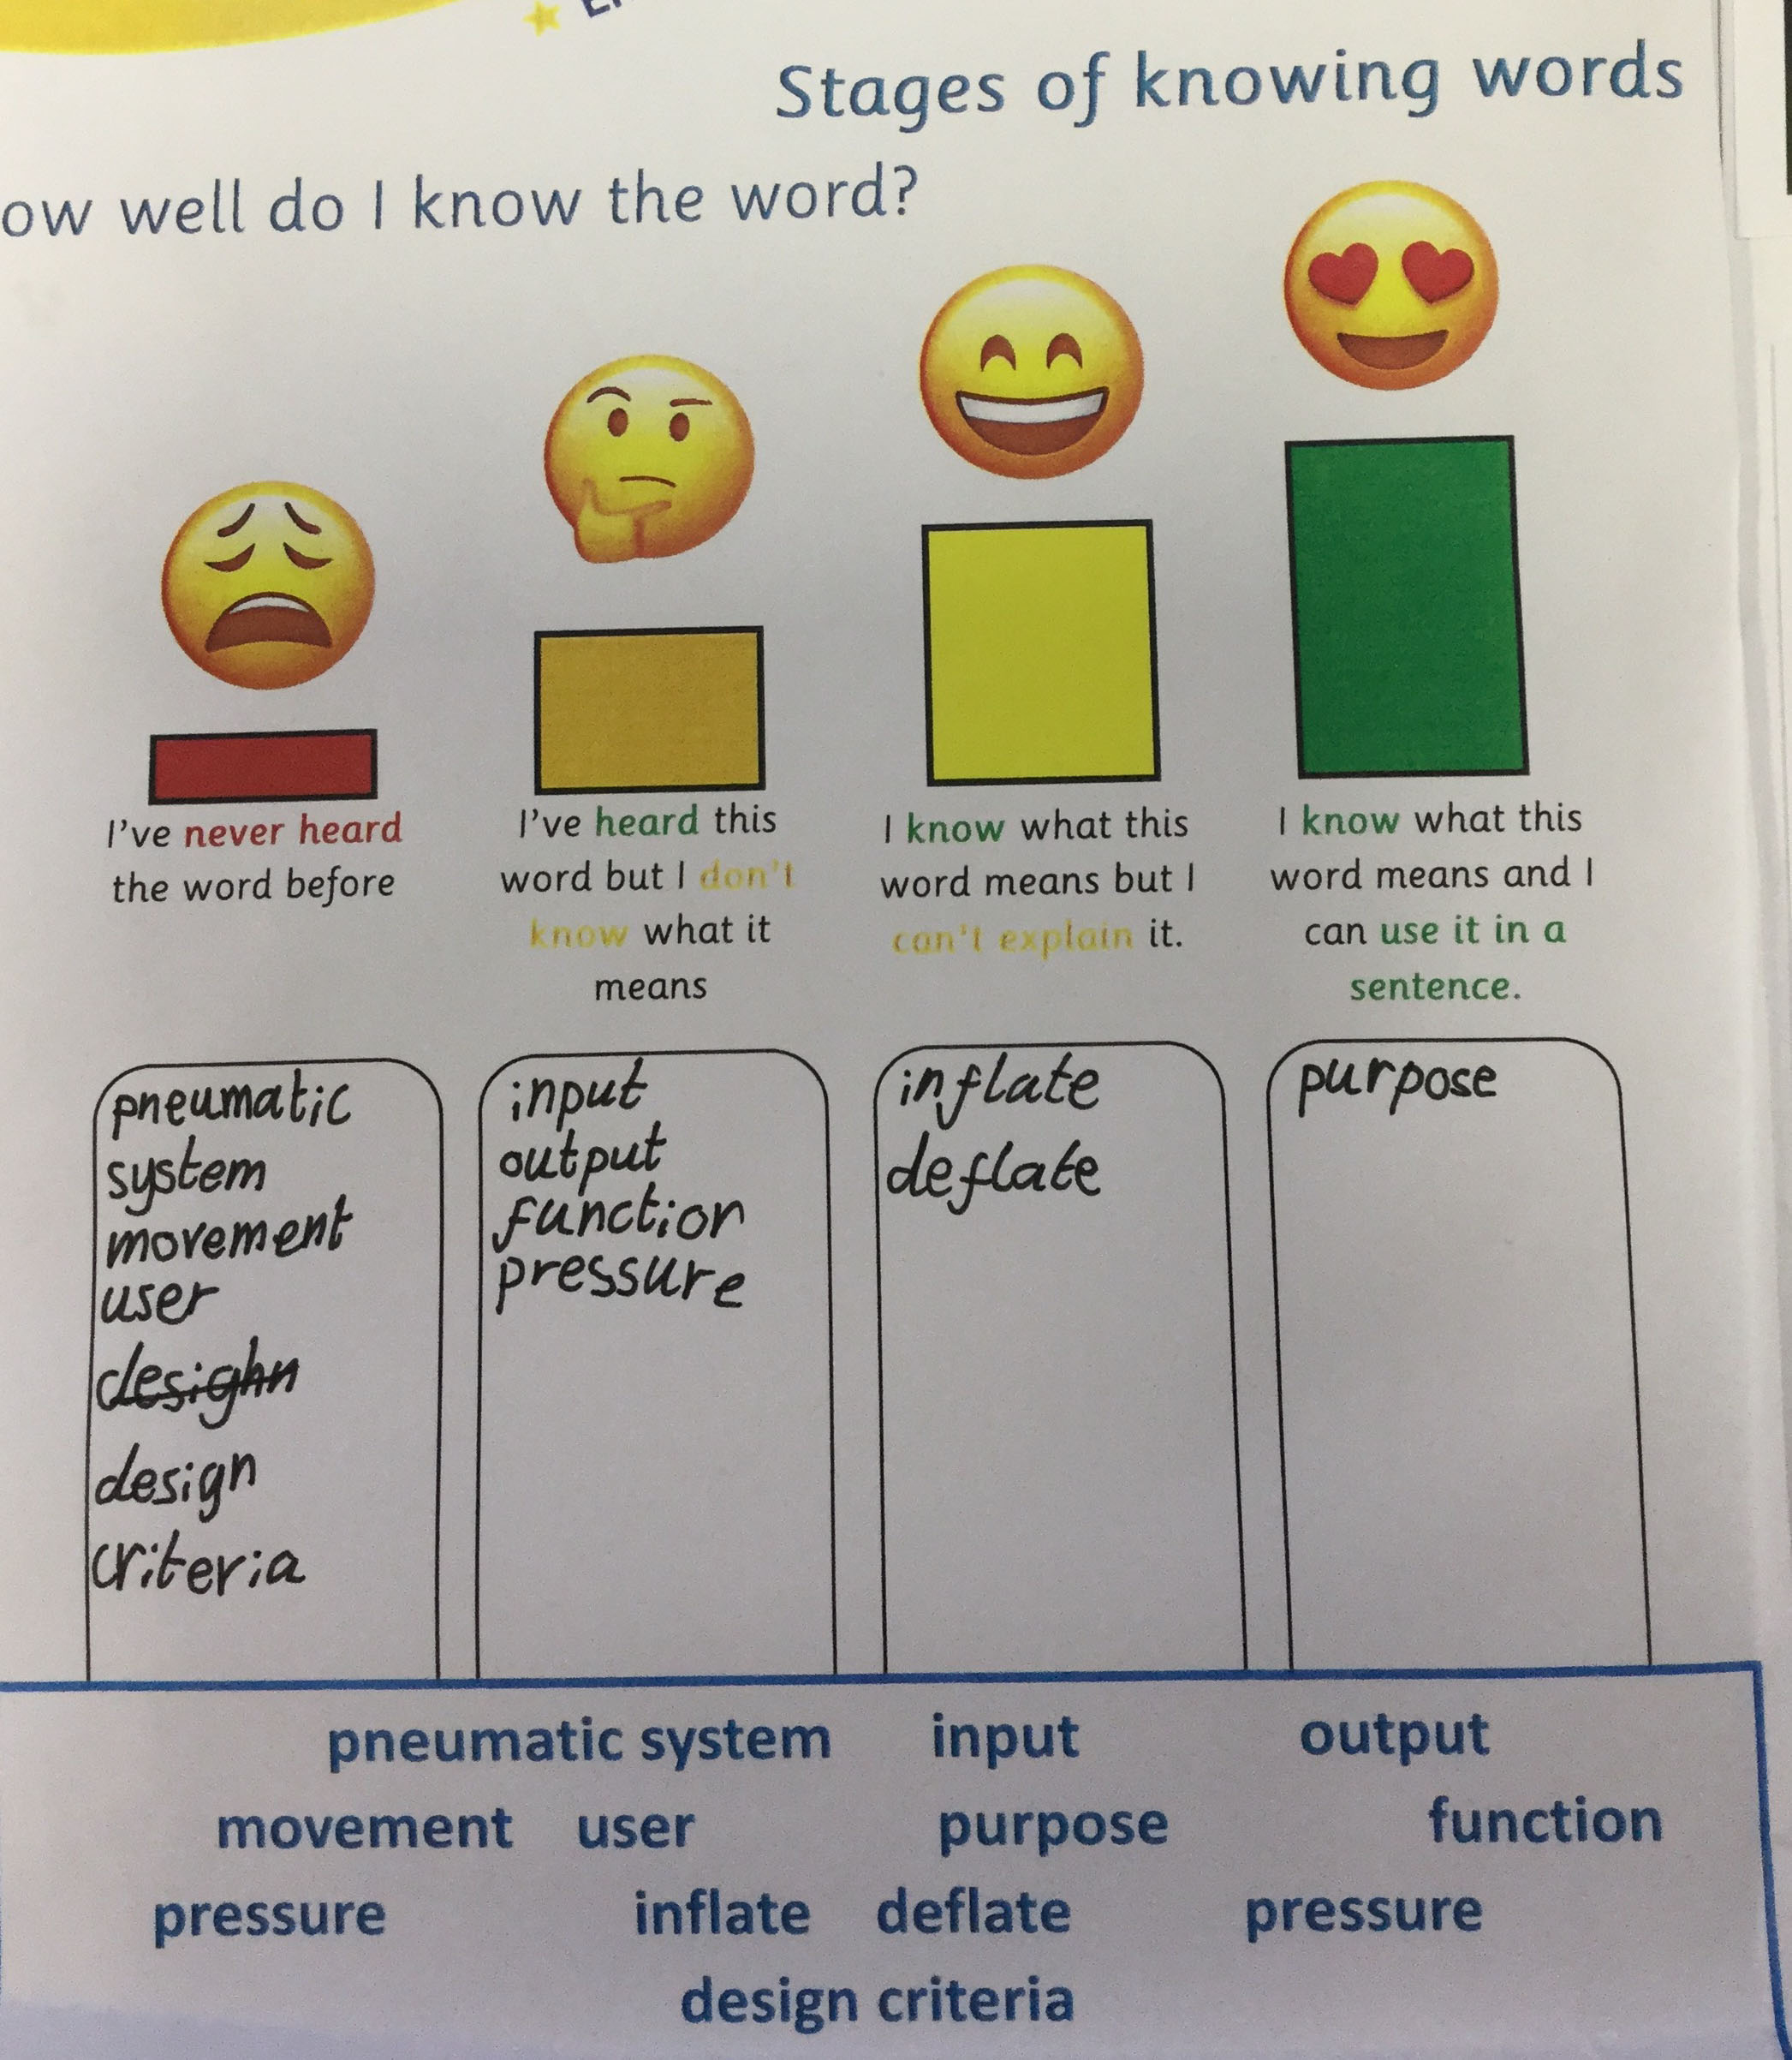
Vocabulary Needed

Slide 3
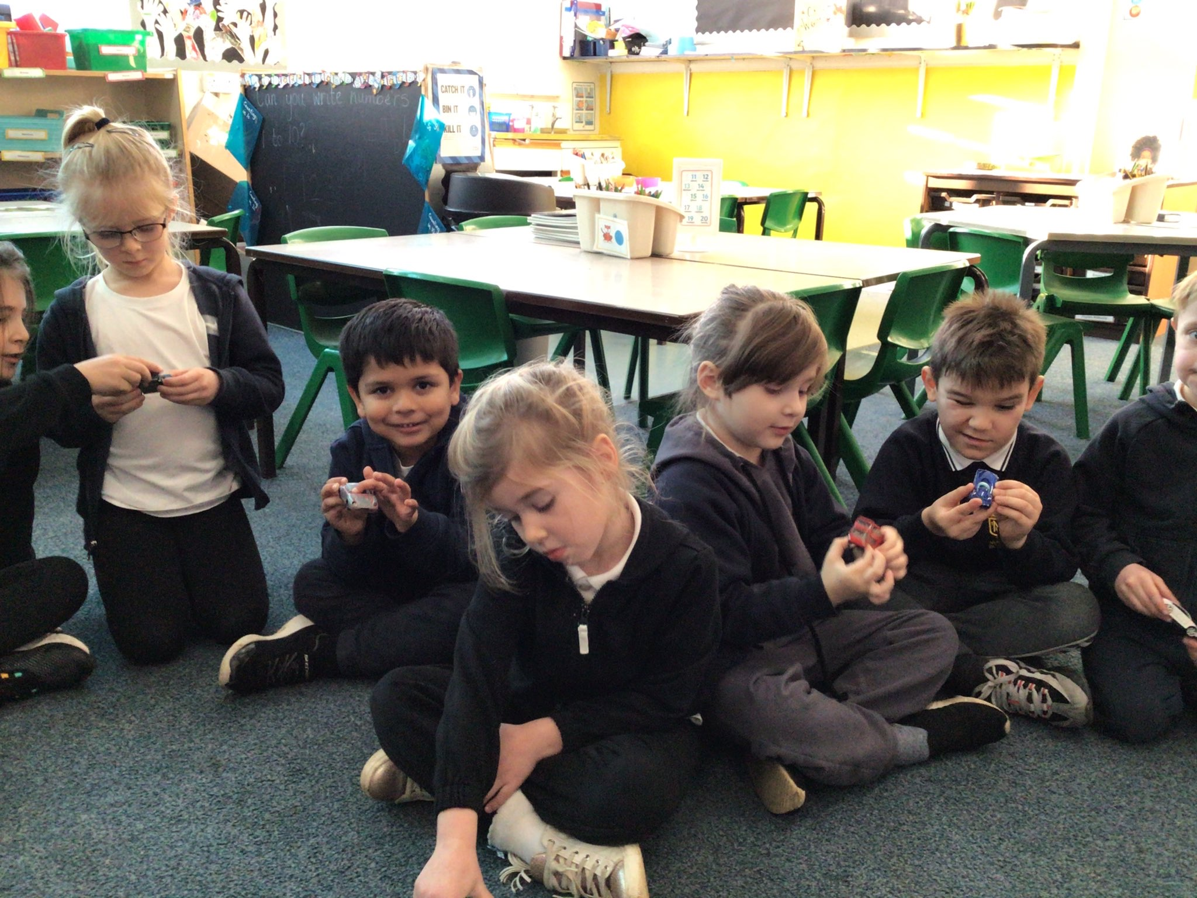
Investigate and Evaluate Existing Products and Materials

Slide 4
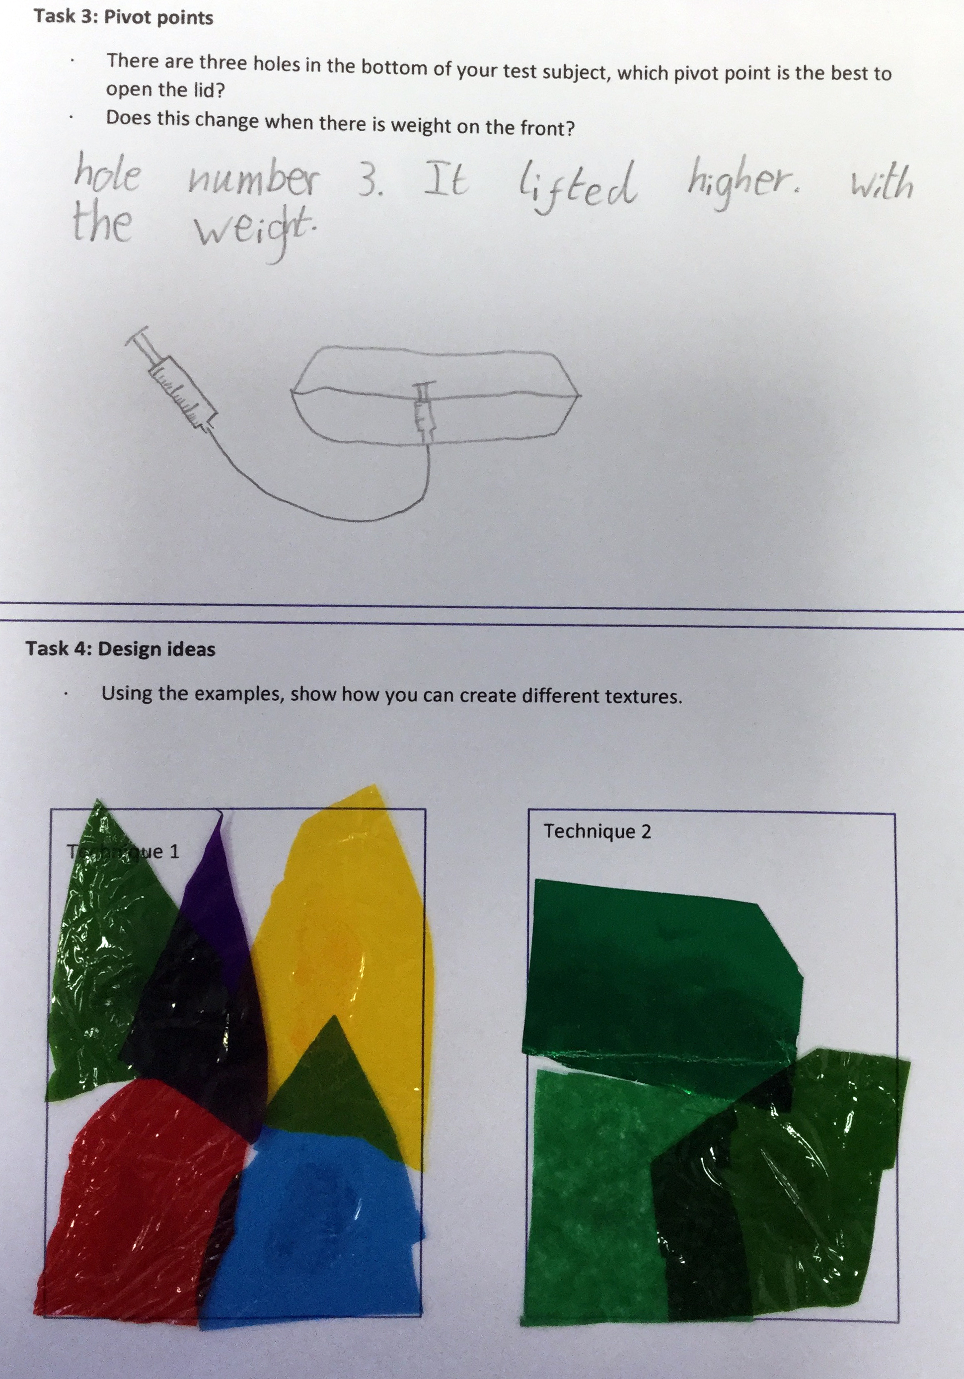
Focused Practical Tasks

Slide 5
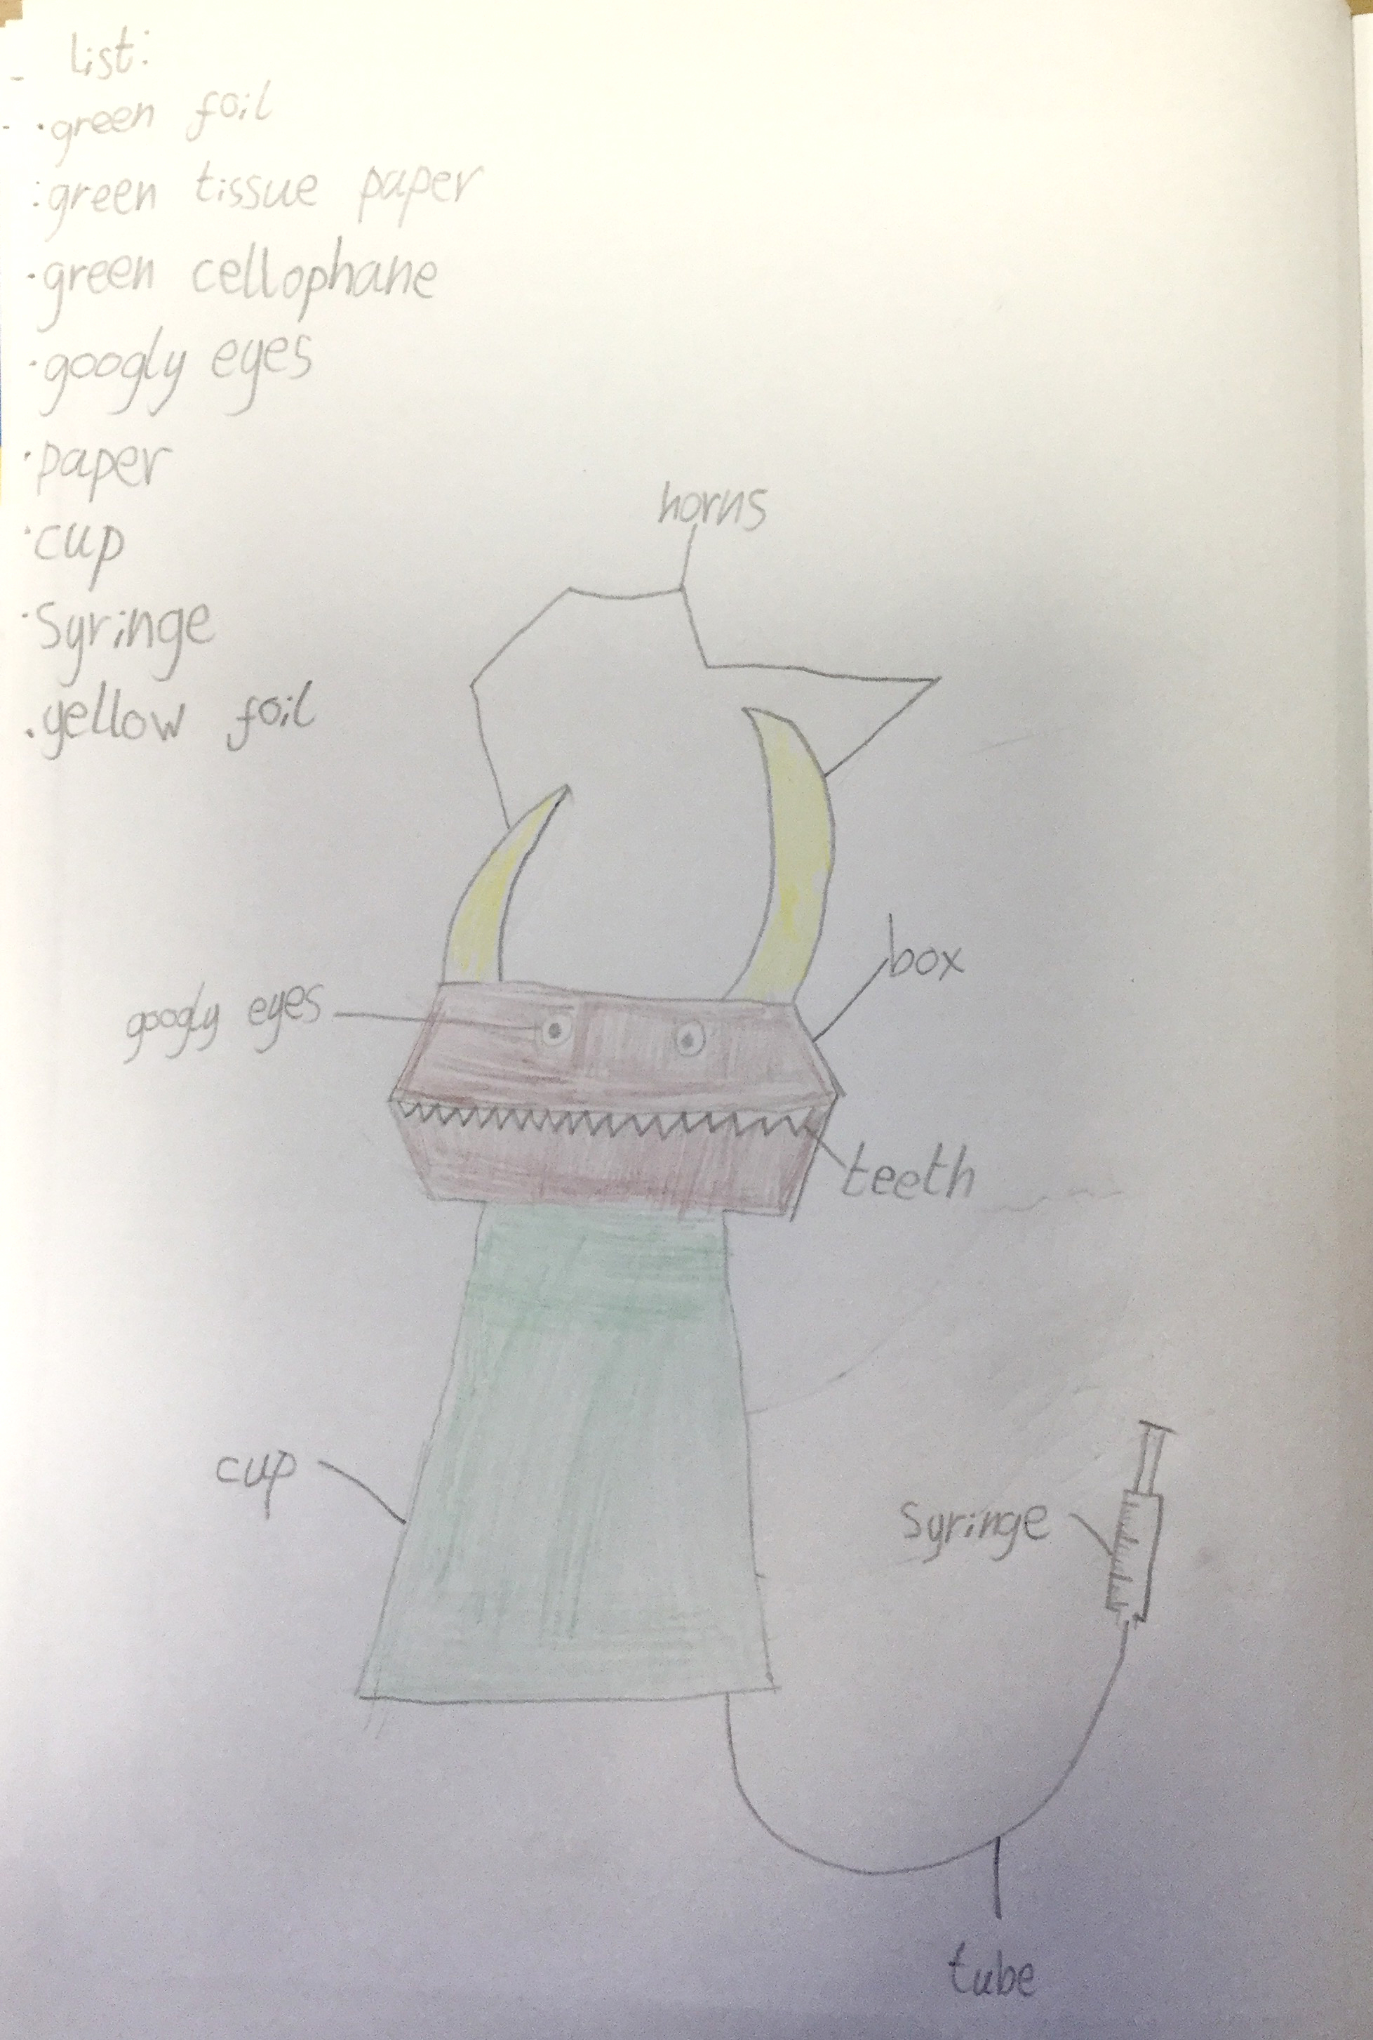
Design and Plan

Slide 6
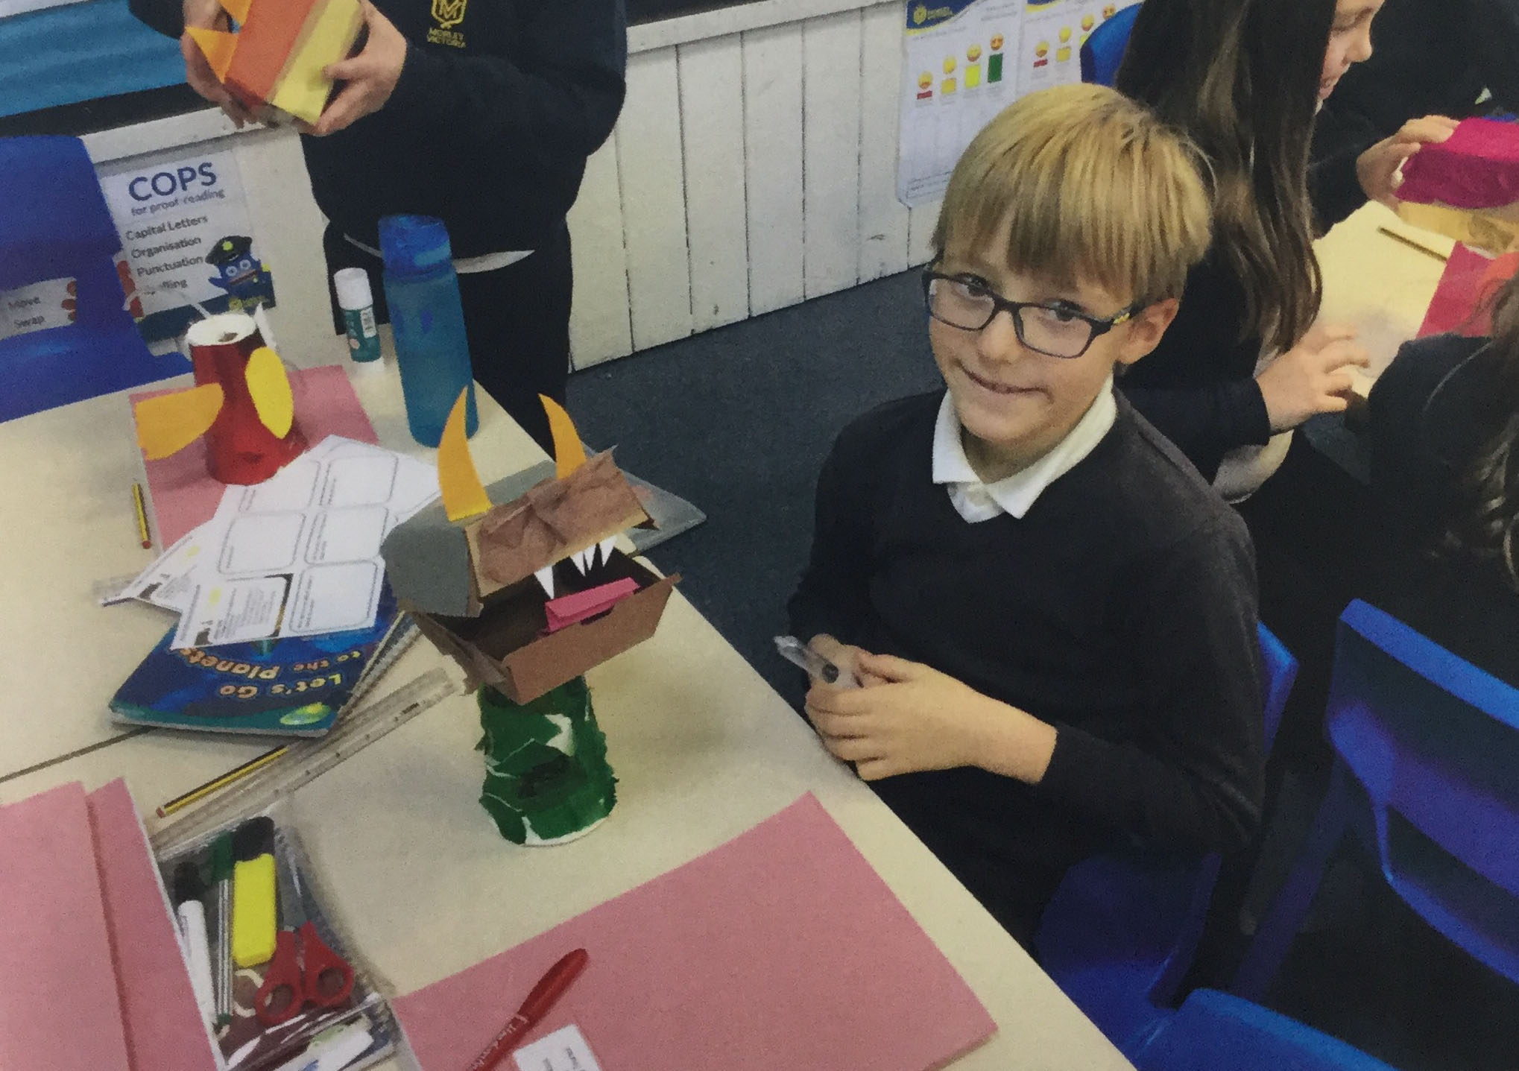
Make

Slide 7
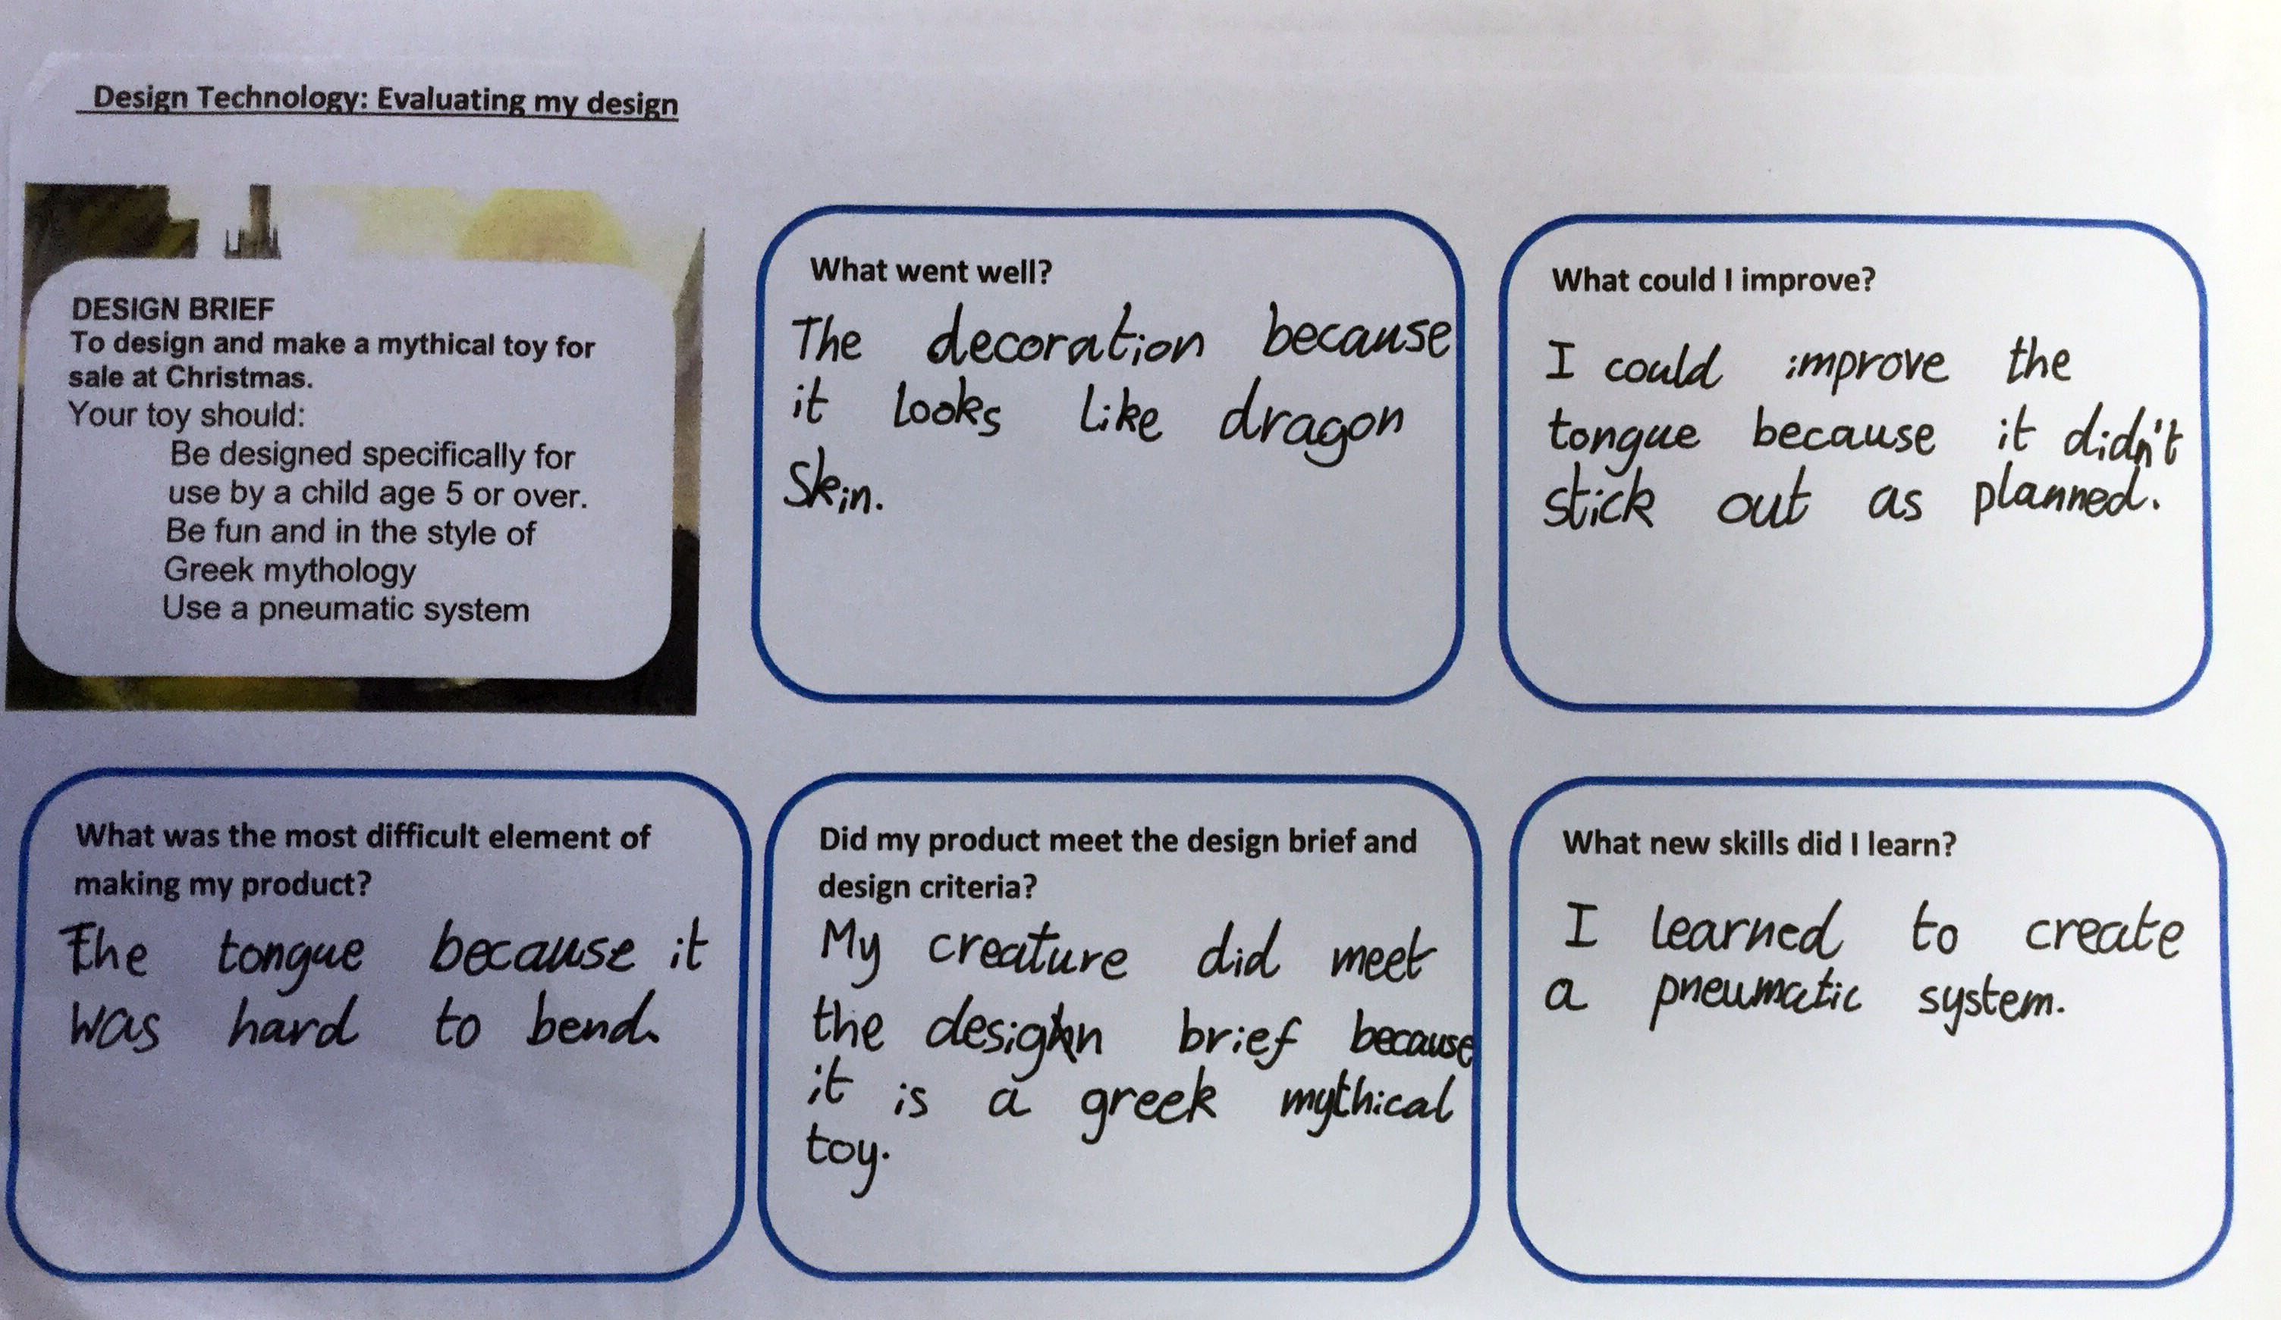
Test and Evaluate

Slide 8
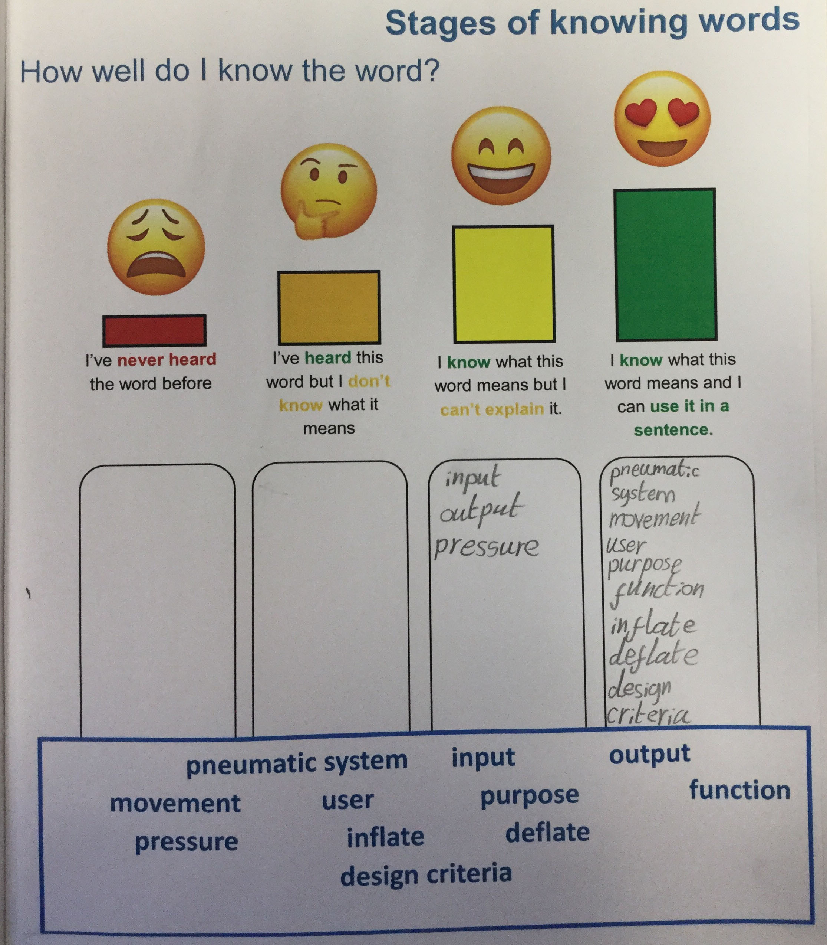
Review of Vocabulary

